Slide 1
haha v8 engine go brrrrr
Syed Faraz Abrar

Slide 2

whoami
Cyber Security Undergraduate @ Curtin University
Security Researcher @ elttam
Currently focusing on Chrome

Slide 3
TL;DR
Background information on browsers and sandboxing
Internals of a couple of V8 components
Analysis of a vulnerability for each of them
Focusing on bug hunting, not exploitation
Tips on approaching V8 research

Slide 4
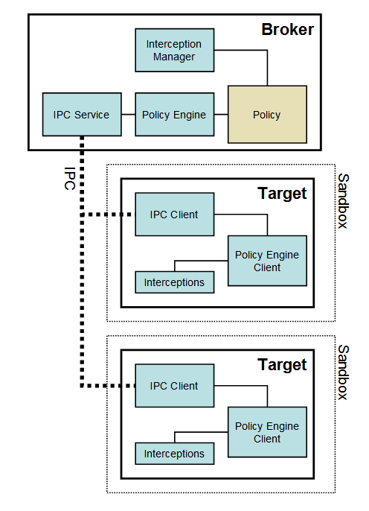
Browsers
Modern browsers are composed of several processes.
https://chromium.googlesource.com/chromium/src/+/master/docs/design/sandbox.md

Slide 5
Browsers
Modern browsers are composed of several processes.
The main Broker process has the most privileges, and handles creating all other Target processes.
https://chromium.googlesource.com/chromium/src/+/master/docs/design/sandbox.md

Slide 6
Browsers
Modern browsers are composed of several processes.
The main Broker process has the most privileges, and handles creating all other Target processes.
These Target processes are considered untrusted by default.
https://chromium.googlesource.com/chromium/src/+/master/docs/design/sandbox.md

Slide 7
Browsers
Modern browsers are composed of several processes.
The main Broker process has the most privileges, and handles creating all other Target processes.
These Target processes are considered untrusted by default.
Renderer processes, GPU processes, DRM processes, etc, are all examples of Target processes.
https://chromium.googlesource.com/chromium/src/+/master/docs/design/sandbox.md

Slide 8
Browsers
Modern browsers are composed of several processes.
The main Broker process has the most privileges, and handles creating all other Target processes.
These Target processes are considered untrusted by default.
Renderer processes, GPU processes, DRM processes, etc, are all examples of Target processes.
All communication is done through IPC.
https://chromium.googlesource.com/chromium/src/+/master/docs/design/sandbox.md

Slide 9
Browsers
Modern browsers are composed of several processes.
The main Broker process has the most privileges, and handles creating all other Target processes.
These Target processes are considered untrusted by default.
Renderer processes, GPU processes, DRM processes, etc, are all examples of Target processes.
All communication is done through IPC.
Child processes are always sandboxed.
https://chromium.googlesource.com/chromium/src/+/master/docs/design/sandbox.md

Slide 10
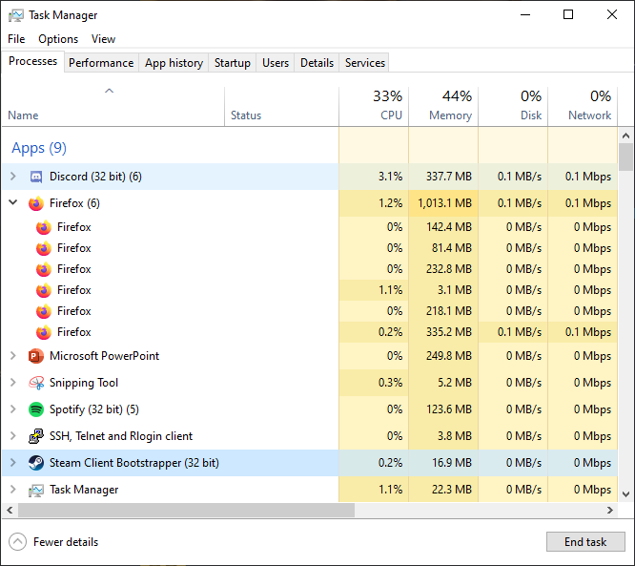
Multiprocess Architecture

Slide 11
Sandboxing (chromium/src/sandbox/)
Sandboxed processes have a number of different restrictions.
Cannot access the file system
Cannot perform arbitrary system calls
Cannot create more child processes
And some more…

Slide 12
Sandboxing (chromium/src/sandbox/)
Sandboxed processes have a number of different restrictions.
Cannot access the file system
Cannot perform arbitrary system calls
Cannot create more child processes
And some more…
Sandboxing is implemented differently in Windows and Linux.
Restricted tokens, Job objects, Desktop objects, and Integrity levels used on Windows
Seccomp-BPF, namespaces, Setuid sandbox, SELinux, and AppArmor used on Linux

Slide 13
Sandboxing (chromium/src/sandbox/)
Sandboxed processes have a number of different restrictions.
Cannot access the file system
Cannot perform arbitrary system calls
Cannot create more child processes
And some more…
Sandboxing is implemented differently in Windows and Linux.
Restricted tokens, Job objects, Desktop objects, and Integrity levels used on Windows
Seccomp-BPF, namespaces, Setuid sandbox, SELinux, and AppArmor used on Linux
The Browser process intercepts all system calls made by the sandboxed processes and handles them.

Slide 14
Motivation for attacking V8
The end goal is to always exploit the Chrome Broker process.

Slide 15
Motivation for attacking V8
The end goal is to always exploit the Chrome Broker process.
Multiple vulnerabilities are needed to achieve this.

Slide 16
Motivation for attacking V8
The end goal is to always exploit the Chrome Broker process.
Multiple vulnerabilities are needed to achieve this.
One of the most exposed processes is the Renderer process.

Slide 17
Motivation for attacking V8
The end goal is to always exploit the Chrome Broker process.
Multiple vulnerabilities are needed to achieve this.
One of the most exposed processes is the Renderer process.
V8 is Chrome’s JavaScript engine, and it runs within every renderer process.

Slide 18
Motivation for attacking V8
The end goal is to always exploit the Chrome Broker process.
Multiple vulnerabilities are needed to achieve this.
One of the most exposed processes is the Renderer process.
V8 is Chrome’s JavaScript engine, and it runs within every renderer process.
The enormous complexity of V8 means it contains entirely new and unique vulnerability classes.

Slide 19
V8 Heap
V8 uses a compressed heap in x86_64.

Slide 20
V8 Heap
V8 uses a compressed heap in x86_64.
All pointers are stored as 32-bit addresses.

Slide 21
V8 Heap
V8 uses a compressed heap in x86_64.
All pointers are stored as 32-bit addresses.
The base address of the heap is stored in the r13 register (called the root register).

Slide 22
V8 Heap
V8 uses a compressed heap in x86_64.
All pointers are stored as 32-bit addresses.
The base address of the heap is stored in the r13 register (called the root register).
The base address is added to pointers prior to dereferencing.

Slide 23
Value Representation
V8 uses a technique called pointer tagging to distinguish between heap pointers and small integers.

Slide 24
Value Representation
V8 uses a technique called pointer tagging to distinguish between heap pointers and small integers.
There are two types of tagged representations: A Smi (short for Small Integer), and a HeapObject.

Slide 25
Value Representation
V8 uses a technique called pointer tagging to distinguish between heap pointers and small integers.
There are two types of tagged representations: A Smi (short for Small Integer), and a HeapObject.
v8/src/objects/objects.h
// Formats of Object::ptr_:
// Smi: [31 bit signed int] 0
// HeapObject: [32 bit direct pointer] (4 byte aligned) | 01

Slide 26
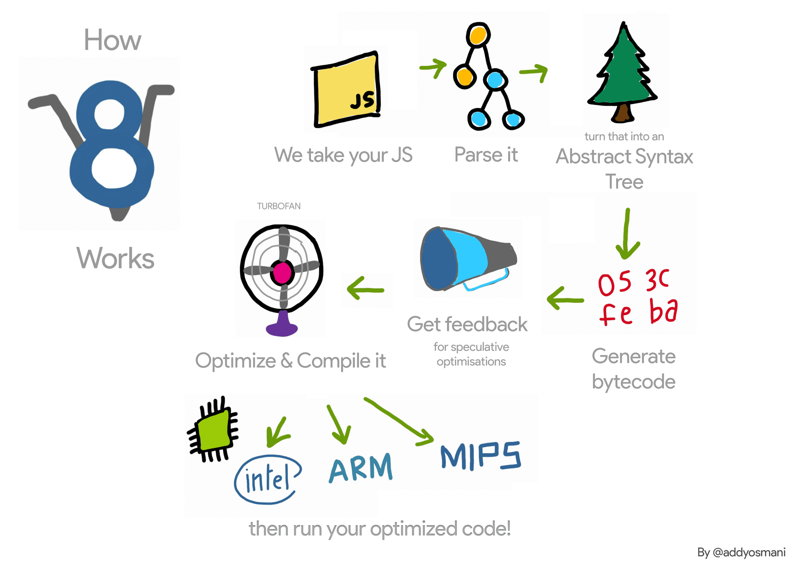
V8 Pipeline
https://ponyfoo.com/articles/an-introduction-to-speculative-optimization-in-v8

Slide 27
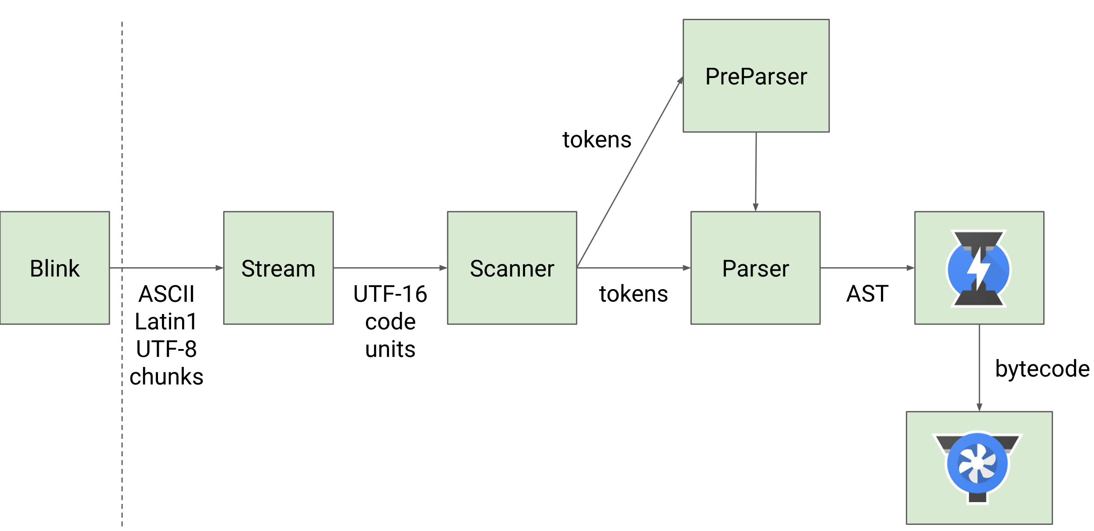
Parsing (v8/src/parsing)
JavaScript code comes in from the network as UTF-8 encoded text.
https://v8.dev/img/scanner/overview.svg

Slide 28
Parsing (v8/src/parsing)
JavaScript code comes in from the network as UTF-8 encoded text.
The Stream converts this to UTF-16, after which the Scanner tokenizes the code.
https://v8.dev/img/scanner/overview.svg

Slide 29
Parsing (v8/src/parsing)
JavaScript code comes in from the network as UTF-8 encoded text.
The Stream converts this to UTF-16, after which the Scanner tokenizes the code.
The Preparser is used for lazy parsing, where it skips parsing any functions, but makes sure they’re syntactically valid.
https://v8.dev/img/scanner/overview.svg

Slide 30
Parsing (v8/src/parsing)
JavaScript code comes in from the network as UTF-8 encoded text.
The Stream converts this to UTF-16, after which the Scanner tokenizes the code.
The Preparser is used for lazy parsing, where it skips parsing any functions, but makes sure they’re syntactically valid.
The Parser simply the code into an Abstract Syntax Tree (AST). The Parser might also parse functions that were Preparsed previously if they are now required to run.
https://v8.dev/img/scanner/overview.svg

Slide 31
Parsing (v8/src/parsing)
The AST is then passed into Ignition, which is V8’s bytecode compiler / interpreter.
https://v8.dev/img/scanner/overview.svg

Slide 32
Parsing (v8/src/parsing)
The AST is then passed into Ignition, which is V8’s bytecode compiler / interpreter.
The Ignition compiler first compiles the AST into bytecode.
https://v8.dev/img/scanner/overview.svg

Slide 33
Parsing (v8/src/parsing)
The AST is then passed into Ignition, which is V8’s bytecode compiler / interpreter.
The Ignition compiler first compiles the AST into bytecode.
Finally, the Ignition interpreter interprets and executes this bytecode.
https://v8.dev/img/scanner/overview.svg

Slide 34
CVE-2019-5790 – LiteralBuffer Integer Overflow
Integer overflow within the Scanner found by Dimitry Fourny of Bluefrostsecurity.

Slide 35
CVE-2019-5790 – LiteralBuffer Integer Overflow
Integer overflow within the Scanner found by Dimitry Fourny of Bluefrostsecurity.
The Scanner::Scan method starts off by calling Scanner::ScanSingleToken to read in a single token.

Slide 36
CVE-2019-5790 – LiteralBuffer Integer Overflow
Integer overflow within the Scanner found by Dimitry Fourny of Bluefrostsecurity.
The Scanner::Scan method starts off by calling Scanner::ScanSingleToken to read in a single token.
Let’s take a String as an example. We get the following call stack:
Scanner::Scan -> Scanner::ScanSingleToken -> Scanner::ScanString -> Scanner::AddLiteralChar -> Scanner::LiteralBuffer::AddChar -> Scanner::LiteralBuffer::AddTwoByteChar

Slide 37
CVE-2019-5790 – LiteralBuffer Integer Overflow
void Scanner::LiteralBuffer::AddTwoByteChar(uc32 code_unit) {
DCHECK(!is_one_byte());
if (position_ >= backing_store_.length()) ExpandBuffer();
if (code_unit <=
static_cast(unibrow::Utf16::kMaxNonSurrogateCharCode)) {
*reinterpret_cast<uint16_t*>(&backing_store_[position_]) = code_unit;
position_ += kUC16Size;
} else {
*reinterpret_cast<uint16_t*>(&backing_store_[position_]) =
unibrow::Utf16::LeadSurrogate(code_unit);
position_ += kUC16Size;
if (position_ >= backing_store_.length()) ExpandBuffer();
*reinterpret_cast<uint16_t*>(&backing_store_[position_]) =
unibrow::Utf16::TrailSurrogate(code_unit);
position_ += kUC16Size;
}
}

Slide 38
CVE-2019-5790 – LiteralBuffer Integer Overflow
void Scanner::LiteralBuffer::ExpandBuffer() {
Vector new_store = Vector::New(NewCapacity(kInitialCapacity));
MemCopy(new_store.start(), backing_store_.start(), position_);
backing_store_.Dispose();
backing_store_ = new_store;
}
kInitialCapacity = 16;
int Scanner::LiteralBuffer::NewCapacity(int min_capacity) {
int capacity = Max(min_capacity, backing_store_.length());
int new_capacity = Min(capacity * kGrowthFactor, capacity + kMaxGrowth);
return new_capacity;
}
kGrowthFactor = 4; kMaxGrowth = 1024 * 1024;
What if (capacity * kGrowthFactor) overflows and becomes less than (capacity + kMaxGrowth)?

Slide 39
CVE-2019-5790 – LiteralBuffer Integer Overflow
int length() const {
DCHECK_GE(std::numeric_limits<int>::max(), length_); // max length check
return static_cast<int>(length_);
}
A Vector cannot have a size greater than 2³¹-1.
Proof of Concept:
let s = String.fromCharCode(0x4141).repeat(0x10000001) + "A";
s = "'"+s+"'";
eval(s);
capacity = 2 * 0x10000001 = 0x20000002
capacity * kGrowthFactory = 0x20000002 * 4 = 0x80000008
capacity + kMaxGrowth = 0x20000002 + (1024 * 1024) = 0x20100002
32-bit signed integer max value = 2³¹-1 = 0x7FFFFFFF
The first calculation overflows and yields a smaller value than the original capacity. This will in turn result in a heap overflow when the MemCopy is called later on.

Slide 40
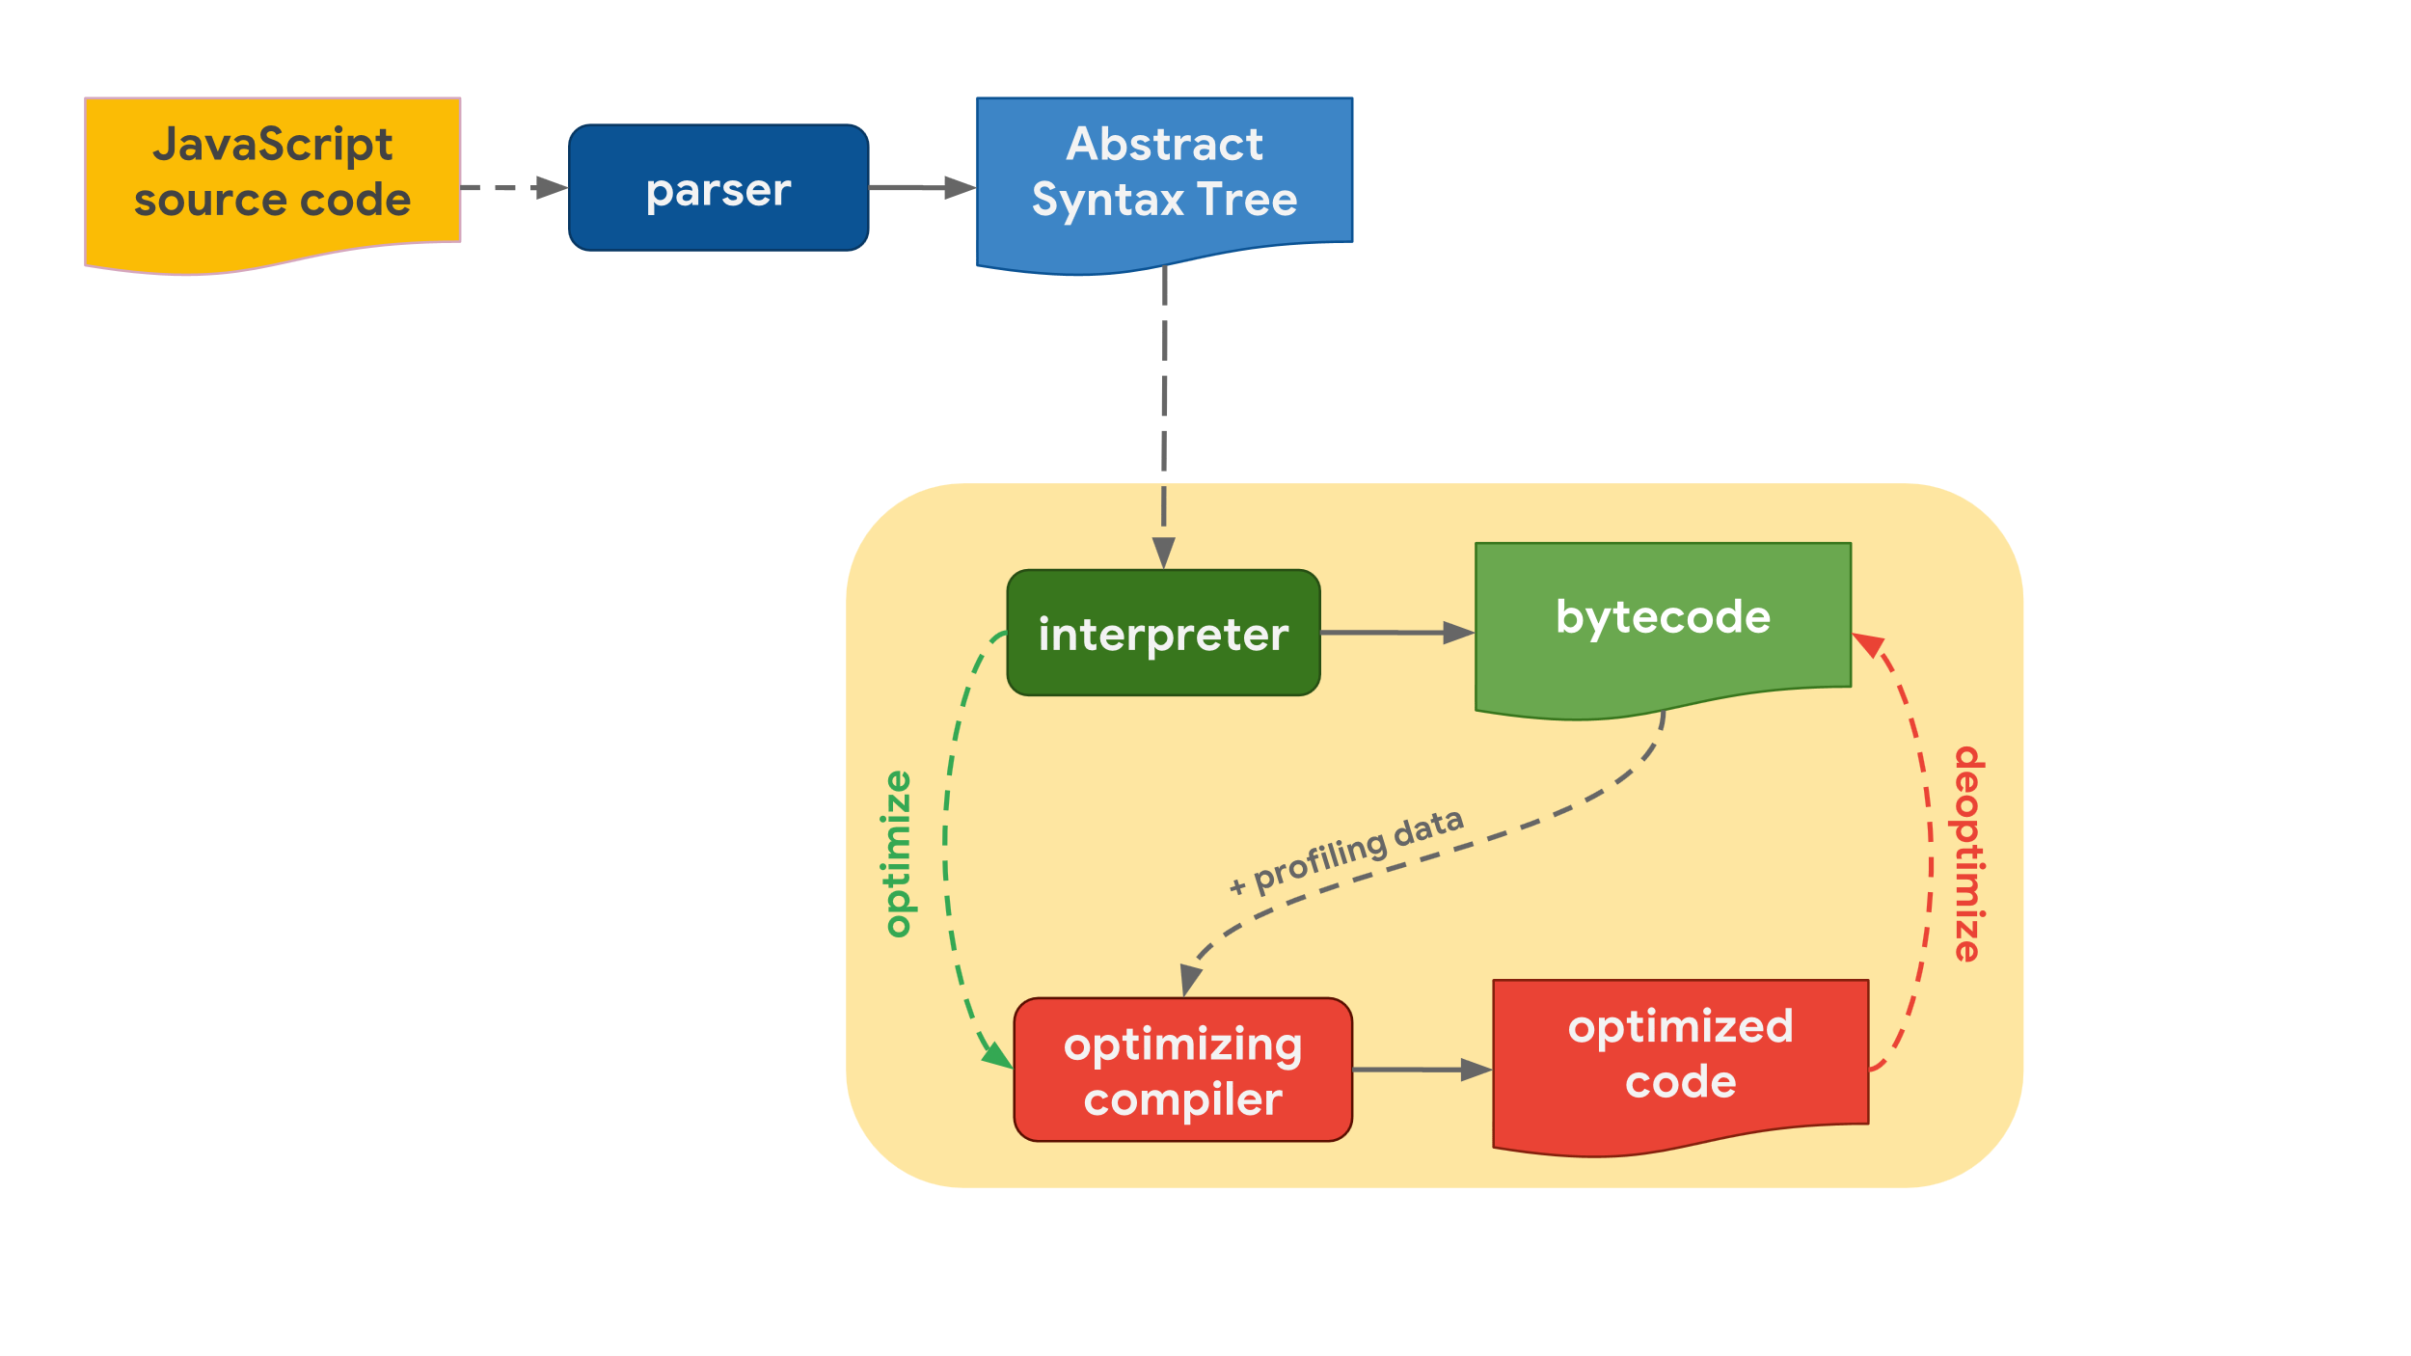
Ignition (v8/src/ignition)
Ignition is V8’s fast low-level register-based interpreter.
https://mathiasbynens.be/notes/shapes-ics

Slide 41
Ignition (v8/src/ignition)
Ignition is V8’s fast low-level register-based interpreter.
It takes the AST generated by the Parser and compiles it to V8-unique bytecode.
https://mathiasbynens.be/notes/shapes-ics

Slide 42
Ignition (v8/src/ignition)
Ignition is V8’s fast low-level register-based interpreter.
It takes the AST generated by the Parser and compiles it to V8-unique bytecode.
Ignition has a number of different registers that all bytecodes will explicitly use as inputs and outputs.
https://mathiasbynens.be/notes/shapes-ics

Slide 43
Ignition (v8/src/ignition)
Ignition is V8’s fast low-level register-based interpreter.
It takes the AST generated by the Parser and compiles it to V8-unique bytecode.
Ignition has a number of different registers that all bytecodes will explicitly use as inputs and outputs.
A special register known as the accumulator register is used for calculations and return values (similar to RAX in x86).
https://mathiasbynens.be/notes/shapes-ics

Slide 44
Bytecode Execution
function add(x, y) {
return x + y;
}
console.log(add(1, 2));
$ out/Debug/d8 --print-bytecode add.js
…
[generated bytecode for function: add]
Parameter count 3
Frame size 0
12 E> 0x37738712a02a @ 0 : 94 StackCheck
23 S> 0x37738712a02b @ 1 : 1d 02 Ldar a1
32 E> 0x37738712a02d @ 3 : 29 03 00 Add a0, [0]
36 S> 0x37738712a030 @ 6 : 98 Return
Constant pool (size = 0)
Handler Table (size = 16)
https://ponyfoo.com/articles/an-introduction-to-speculative-optimization-in-v8

Slide 45
Bytecode Execution
function add(x, y) {
return x + y;
}
console.log(add(1, 2));
$ out/Debug/d8 --print-bytecode add.js
…
[generated bytecode for function: add]
Parameter count 3
Frame size 0
12 E> 0x37738712a02a @ 0 : 94 StackCheck
23 S> 0x37738712a02b @ 1 : 1d 02 Ldar a1
32 E> 0x37738712a02d @ 3 : 29 03 00 Add a0, [0]
36 S> 0x37738712a030 @ 6 : 98 Return
Constant pool (size = 0)
Handler Table (size = 16)
https://ponyfoo.com/articles/an-introduction-to-speculative-optimization-in-v8

Slide 46
Bytecode Execution
function add(x, y) {
return x + y;
}
console.log(add(1, 2));
$ out/Debug/d8 --print-bytecode add.js
…
[generated bytecode for function: add]
Parameter count 3
Frame size 0
12 E> 0x37738712a02a @ 0 : 94 StackCheck
23 S> 0x37738712a02b @ 1 : 1d 02 Ldar a1
32 E> 0x37738712a02d @ 3 : 29 03 00 Add a0, [0]
36 S> 0x37738712a030 @ 6 : 98 Return
Constant pool (size = 0)
Handler Table (size = 16)
https://ponyfoo.com/articles/an-introduction-to-speculative-optimization-in-v8

Slide 47
Bytecode Execution
function add(x, y) {
return x + y;
}
console.log(add(1, 2));
$ out/Debug/d8 --print-bytecode add.js
…
[generated bytecode for function: add]
Parameter count 3
Frame size 0
12 E> 0x37738712a02a @ 0 : 94 StackCheck
23 S> 0x37738712a02b @ 1 : 1d 02 Ldar a1
32 E> 0x37738712a02d @ 3 : 29 03 00 Add a0, [0]
36 S> 0x37738712a030 @ 6 : 98 Return
Constant pool (size = 0)
Handler Table (size = 16)
https://ponyfoo.com/articles/an-introduction-to-speculative-optimization-in-v8

Slide 48
Bytecode Execution
function add(x, y) {
return x + y;
}
console.log(add(1, 2));
$ out/Debug/d8 --print-bytecode add.js
…
[generated bytecode for function: add]
Parameter count 3
Frame size 0
12 E> 0x37738712a02a @ 0 : 94 StackCheck
23 S> 0x37738712a02b @ 1 : 1d 02 Ldar a1
32 E> 0x37738712a02d @ 3 : 29 03 00 Add a0, [0]
36 S> 0x37738712a030 @ 6 : 98 Return
Constant pool (size = 0)
Handler Table (size = 16)
https://ponyfoo.com/articles/an-introduction-to-speculative-optimization-in-v8

Slide 49
TurboFan (v8/src/compiler)
When a function is ran several times, it becomes hot.
https://mathiasbynens.be/notes/shapes-ics

Slide 50
TurboFan (v8/src/compiler)
When a function is ran several times, it becomes hot.
Using type feedback and profiling information collected by the interpreter, TurboFan speculates that the function only deals with a certain type of value.
https://mathiasbynens.be/notes/shapes-ics

Slide 51
TurboFan (v8/src/compiler)
When a function is ran several times, it becomes hot.
Using type feedback and profiling information collected by the interpreter, TurboFan speculates that the function only deals with a certain type of value.
It uses these speculations as assumptions to produce highly optimized machine code.
https://mathiasbynens.be/notes/shapes-ics

Slide 52
TurboFan (v8/src/compiler)
When a function is ran several times, it becomes hot.
Using type feedback and profiling information collected by the interpreter, TurboFan speculates that the function only deals with a certain type of value.
It uses these speculations as assumptions to produce highly optimized machine code.
If at any point these assumptions fail to hold true, the code is deoptimized and execution goes back to Ignition.
https://mathiasbynens.be/notes/shapes-ics

Slide 53
Speculative Optimization
function add(x, y) {
return x + y;
}
for (var i = 0; i < 10000; i++) {
add(1, 2);
}
add(1.1, 2.2);
add(1,2); // BinaryOp of SignedSmall
add(1,2); // Stored in Feedback Vector
…
add(1,2); // Optimized for Smis
…
add(1.1, 2.2); // Deoptimize to interpreter

Slide 54
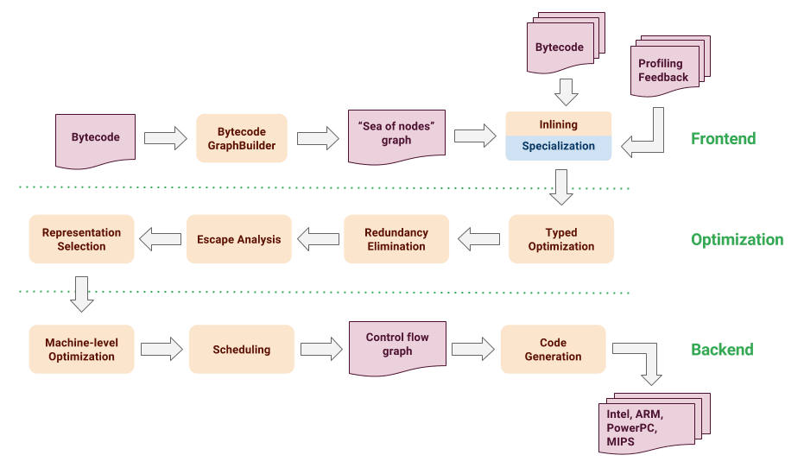
Speculative Optimization
https://ponyfoo.com/articles/an-introduction-to-speculative-optimization-in-v8

Slide 55
Shapes
Shapes (a.k.a HiddenClasses) are used to store information about objects, specifically how their properties are to be accessed.

Slide 56
Shapes
Shapes (a.k.a HiddenClasses) are used to store information about objects, specifically how their properties are to be accessed.
They also track ElementsKinds for arrays.

Slide 57
Shapes
Shapes (a.k.a HiddenClasses) are used to store information about objects, specifically how their properties are to be accessed.
They also track ElementsKinds for arrays.
Shapes are created on-demand as needed, and shared between objects as much as possible.

Slide 58
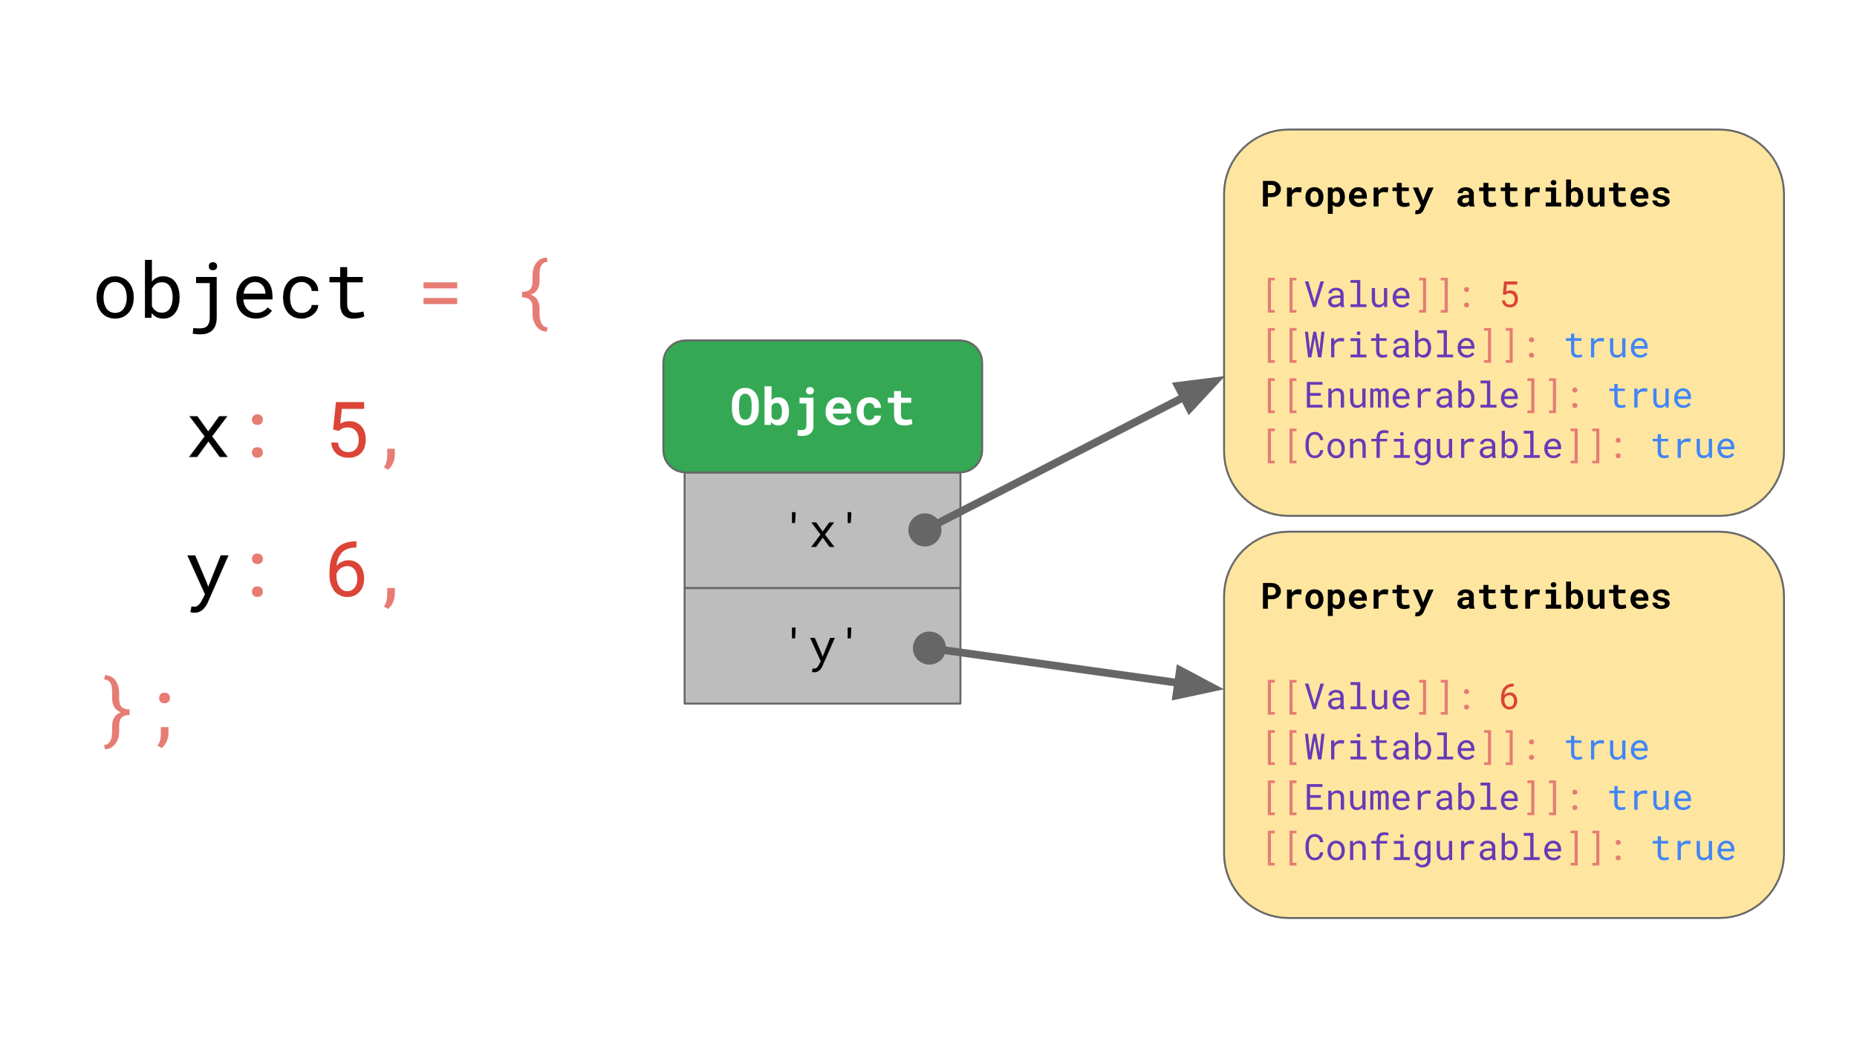
Shapes
https://mathiasbynens.be/notes/shapes-ics

Slide 59
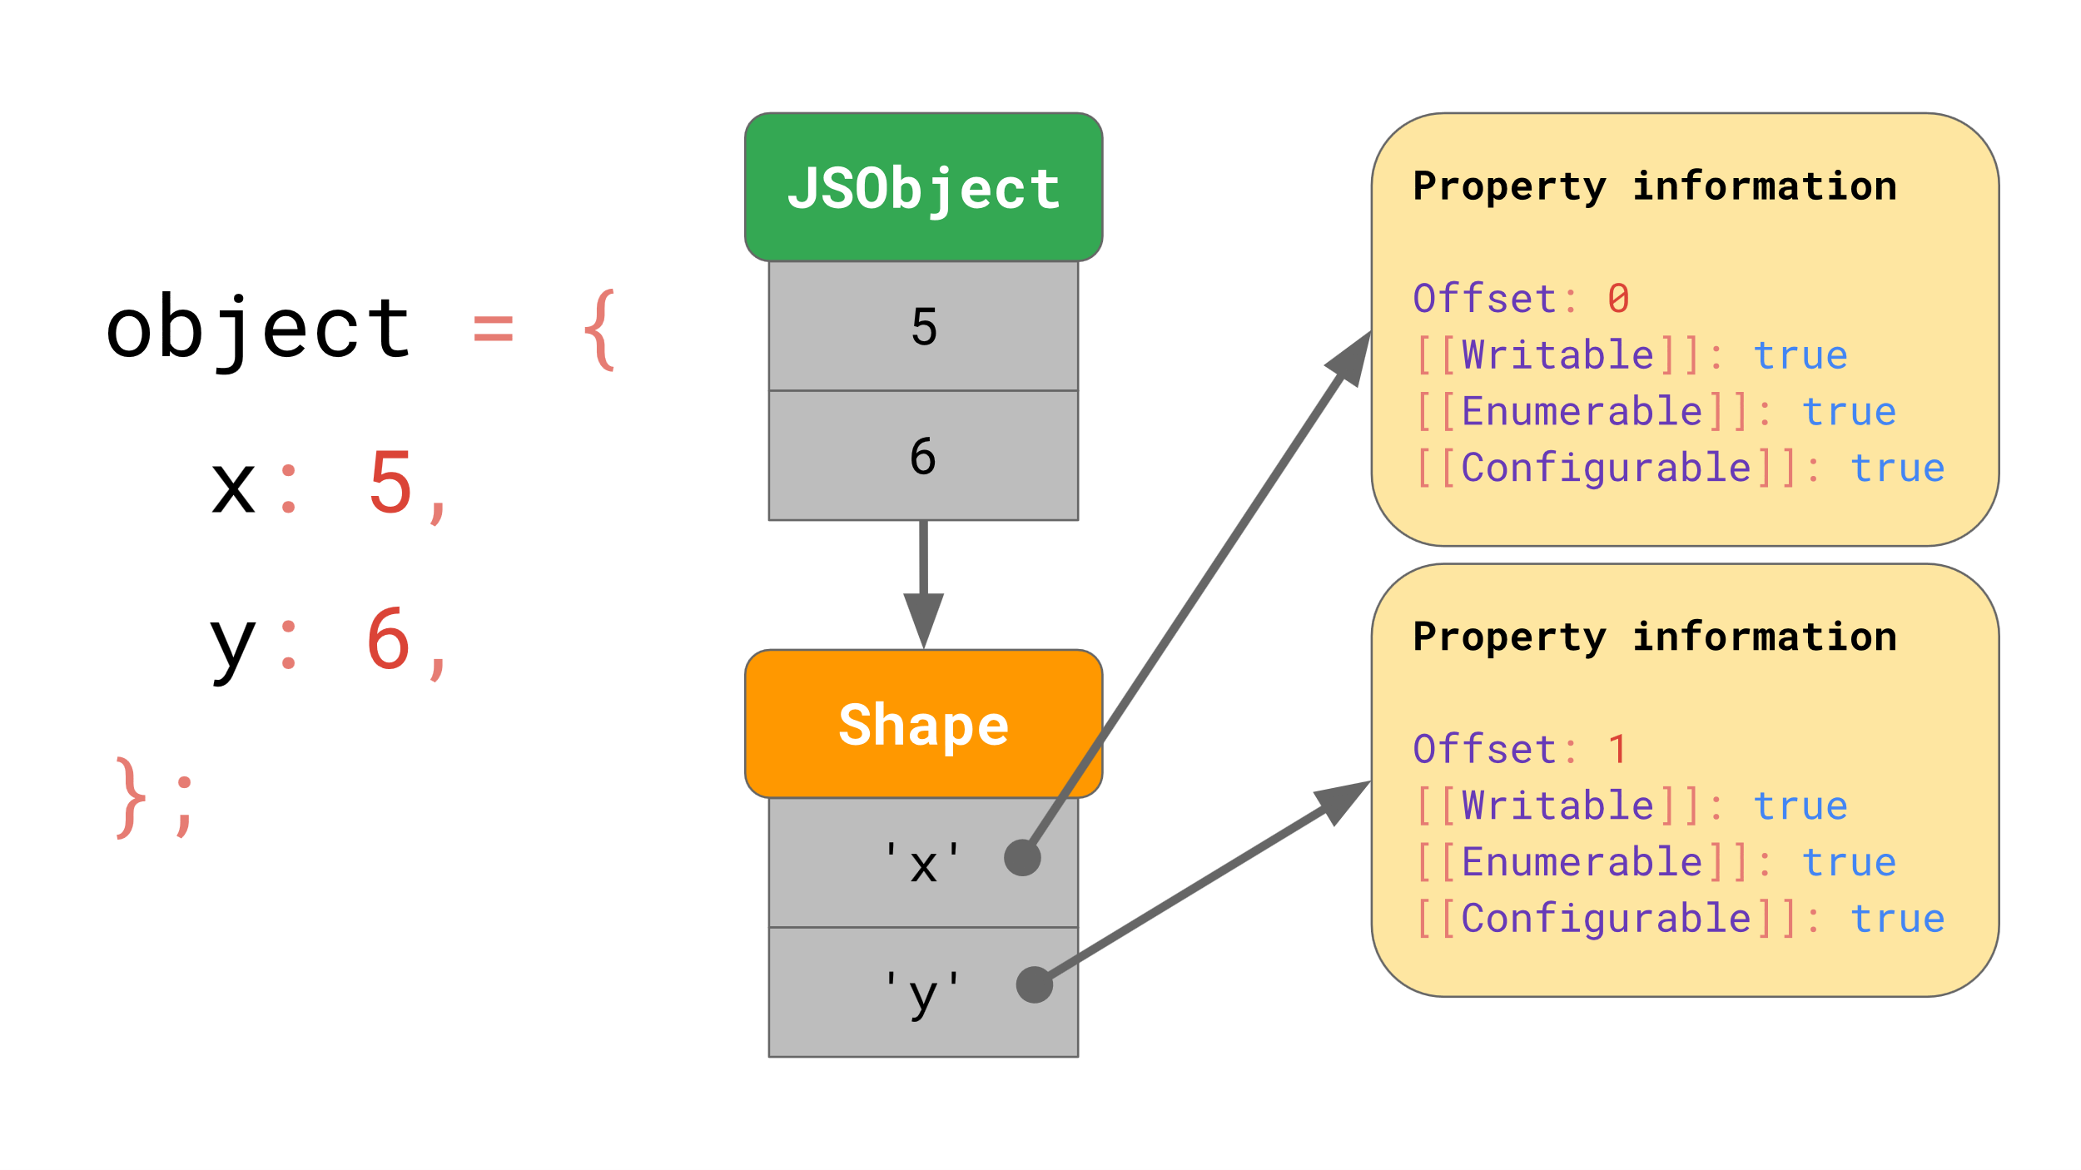
Shapes
https://mathiasbynens.be/notes/shapes-ics

Slide 60
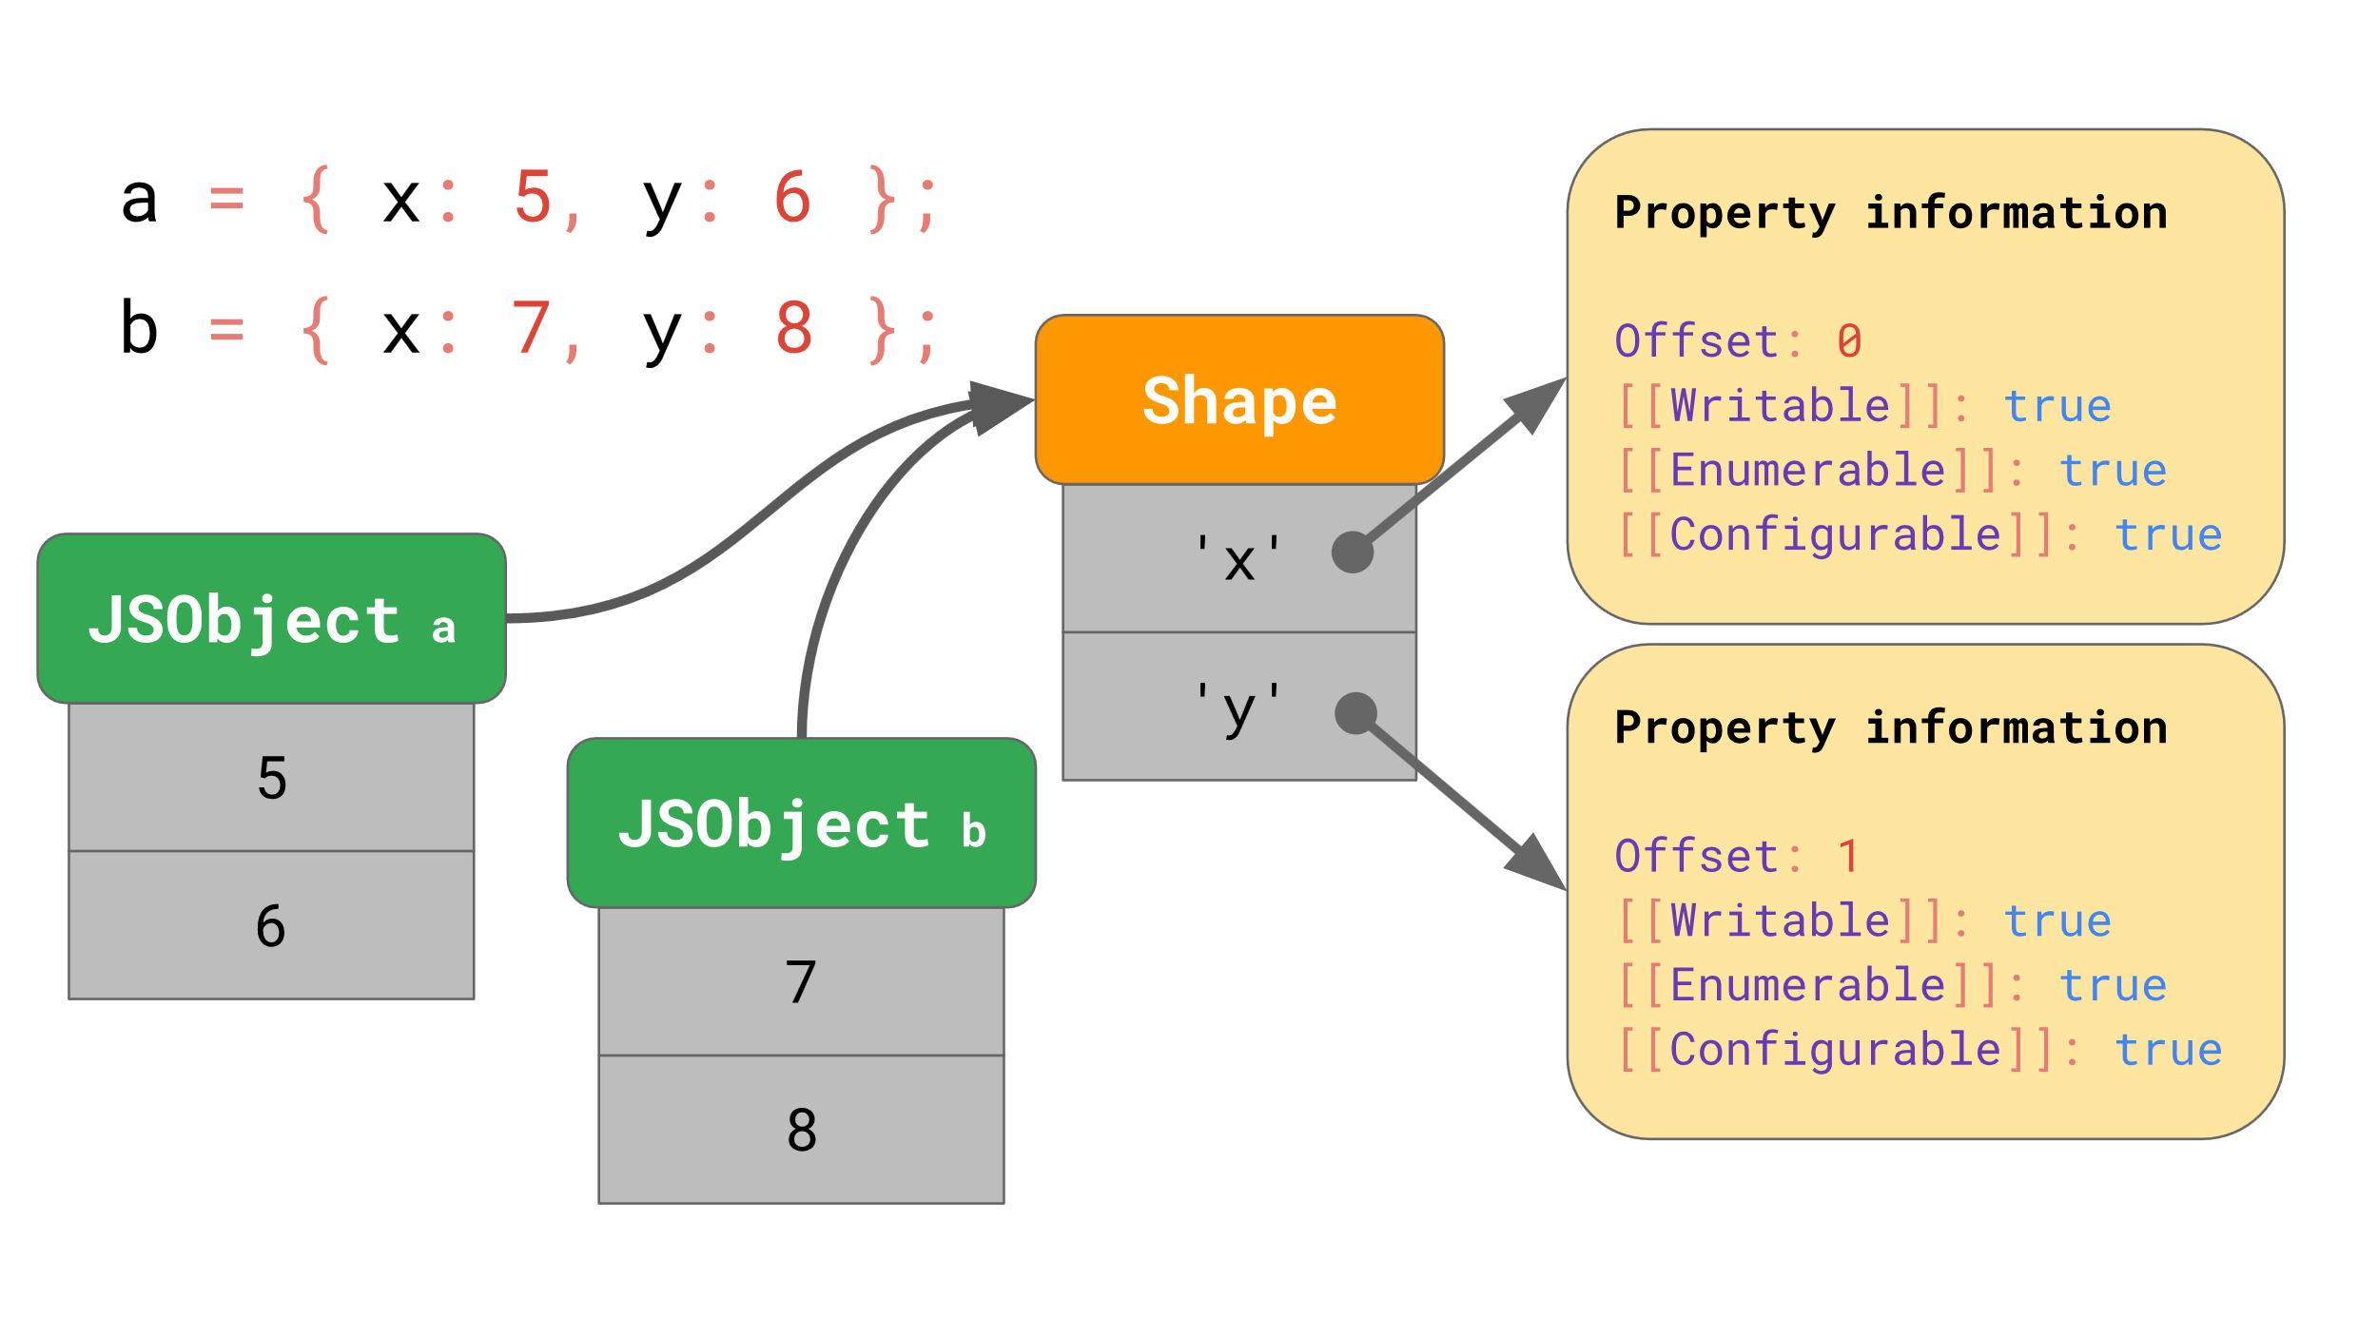
Shapes
https://mathiasbynens.be/notes/shapes-ics

Slide 61
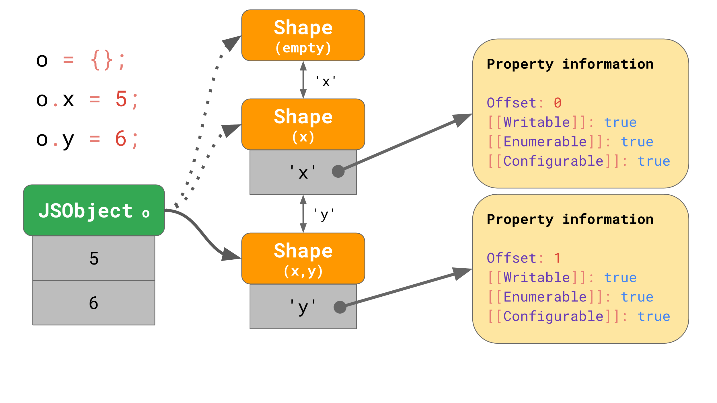
Shapes
https://mathiasbynens.be/notes/shapes-ics

Slide 62
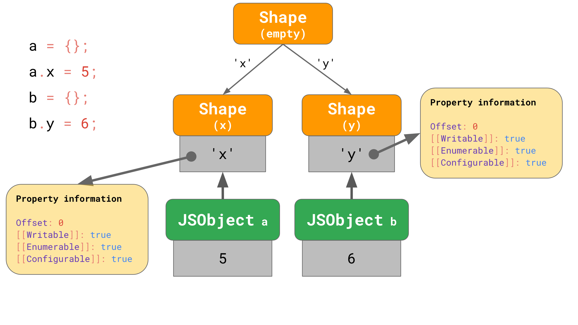
Shapes
https://mathiasbynens.be/notes/shapes-ics

Slide 63
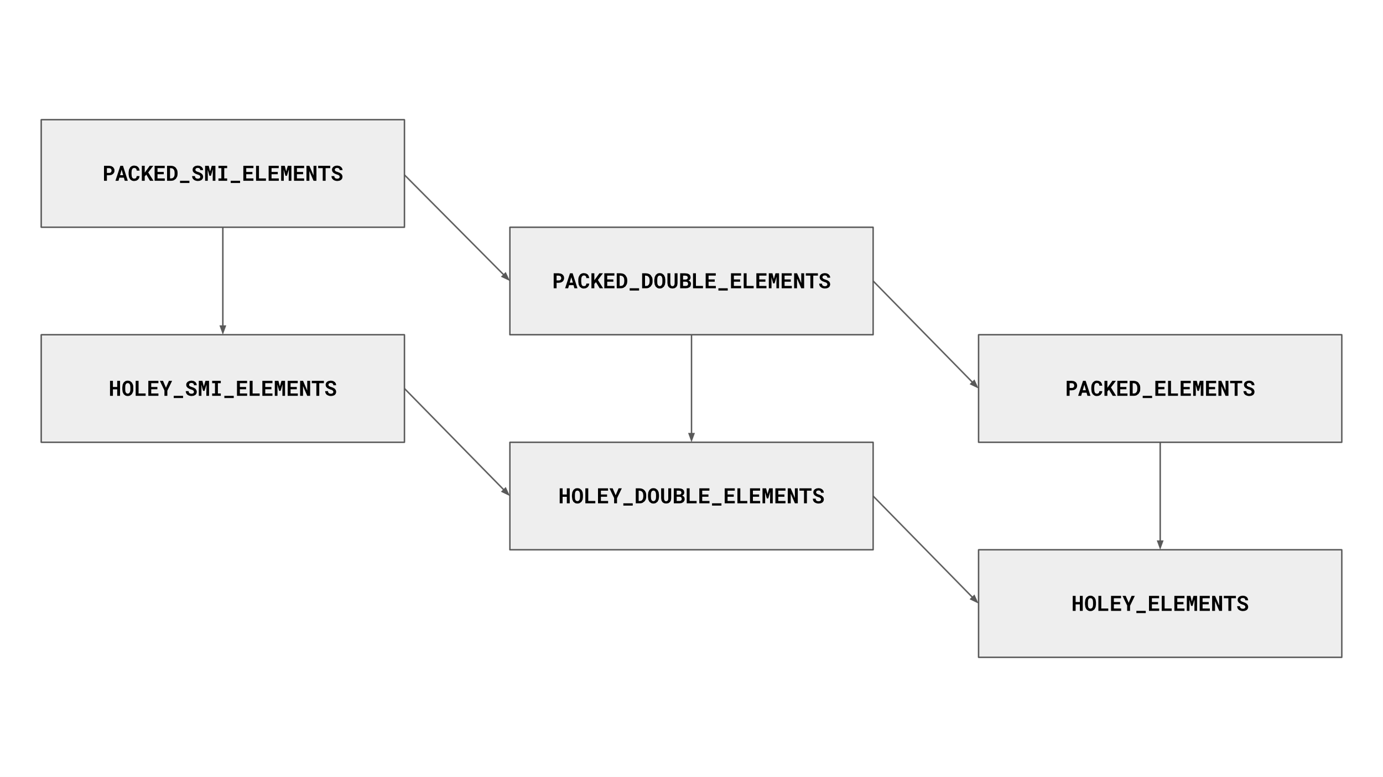
ElementsKind
{1, 2, 3, 4}
{1.1, 2.2, 3.3}
{1.1, {}}
{1,,,4}
{1.1,,,3.3}
{1.1,,,{}}

Slide 64
ElementsKind
{1, 2, 3, 4}
{1.1, 2.2, 3.3}
{1.1, {}}
{1,,,4}
{1.1,,,3.3}
{1.1,,,{}}

Slide 65
ElementsKind
{1, 2, 3, 4}
{1.1, 2.2, 3.3}
{1.1, {}}
{1,,,4}
{1.1,,,3.3}
{1.1,,,{}}

Slide 66
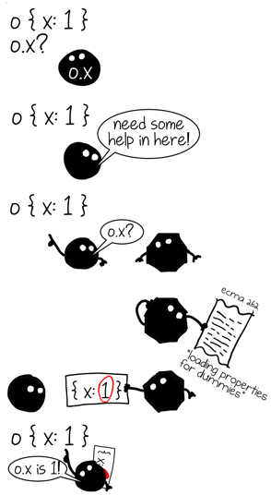
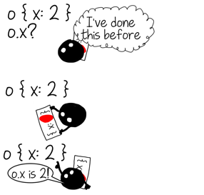
Inline Caches
Inline Caches store information regarding property loads and stores.
Any time an object’s property is accessed within a function, the information regarding this access is stored in the function’s Inline Cache.
When optimized machine code is generated, the code speculates that the same object’s property is accessed, and uses the information stored in the Inline Cache to access the property.

Slide 67
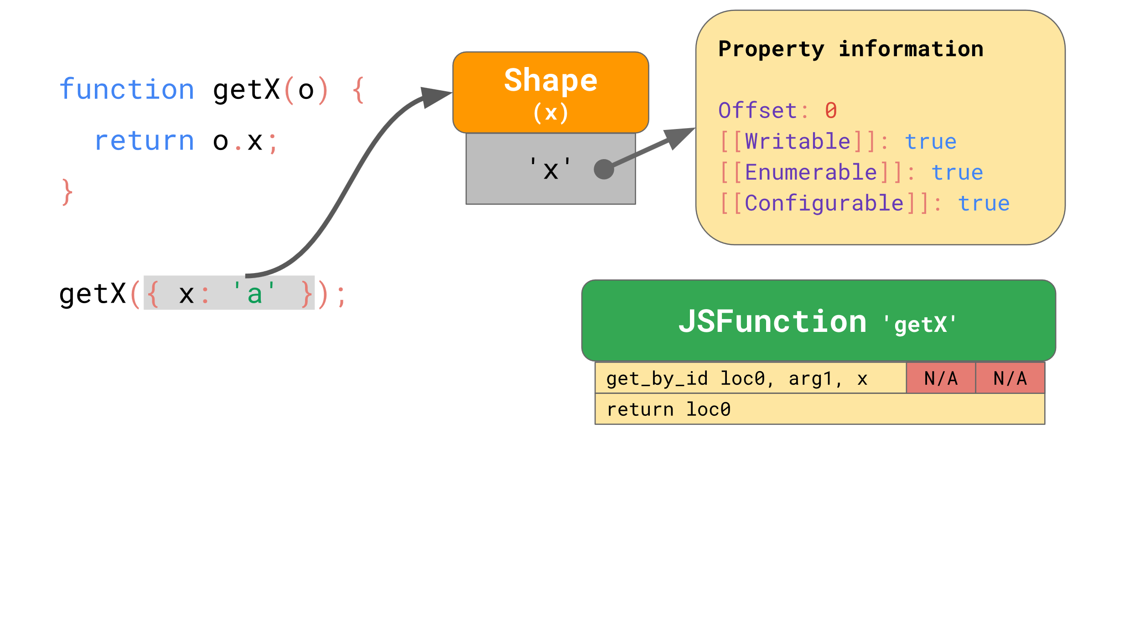
Inline Caches
https://mathiasbynens.be/notes/shapes-ics

Slide 68
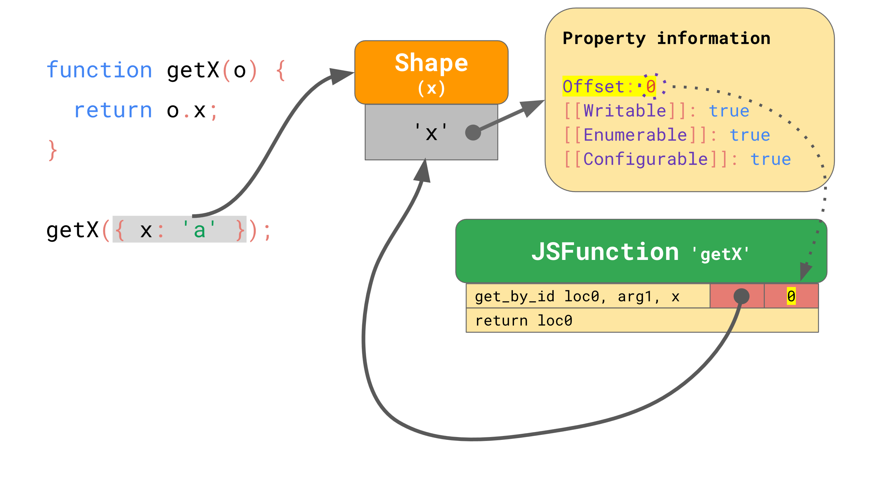
Inline Caches
https://mathiasbynens.be/notes/shapes-ics

Slide 69
Chromium Issue 944062 – Failing to insert Map checks in Array.indexOf and Array.includes
Found by Stephen Röttger (@_tsuro) through manual code review, and by Samuel Groß (@5aelo) through fuzzing.

Slide 70
Chromium Issue 944062 – Failing to insert Map checks in Array.indexOf and Array.includes
Found by Stephen Röttger (@_tsuro) through manual code review, and by Samuel Groß (@5aelo) through fuzzing.
Great writeup by Stephen – Trashing The Flow of Data

Slide 71
Chromium Issue 944062 – Failing to insert Map checks in Array.indexOf and Array.includes
Found by Stephen Röttger (@_tsuro) through manual code review, and by Samuel Groß (@5aelo) through fuzzing.
Great writeup by Stephen – Trashing The Flow of Data
Some more background information regarding TurboFan required.

Slide 72
Chromium Issue 944062 – Failing to insert Map checks in Array.indexOf and Array.includes
TurboFan will take the bytecode generated by Ignition and transform it into a “sea of nodes” graph.

Slide 73
Chromium Issue 944062 – Failing to insert Map checks in Array.indexOf and Array.includes
TurboFan will take the bytecode generated by Ignition and transform it into a “sea of nodes” graph.
The optimizations TurboFan performs are more easily done on the “sea of nodes” graph than on the AST.

Slide 74
Chromium Issue 944062 – Failing to insert Map checks in Array.indexOf and Array.includes
TurboFan will take the bytecode generated by Ignition and transform it into a “sea of nodes” graph.
The optimizations TurboFan performs are more easily done on the “sea of nodes” graph than on the AST.
At the end, this “sea of nodes” graph is lowered down to machine code for a specific architecture.

Slide 75
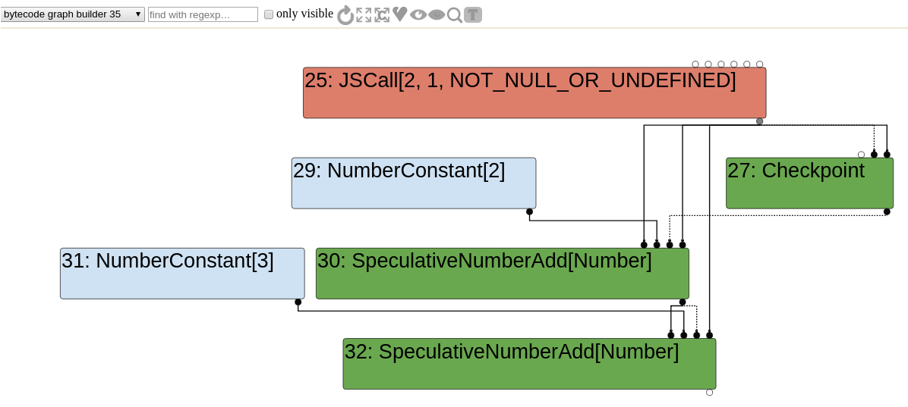
Chromium Issue 944062 – Failing to insert Map checks in Array.indexOf and Array.includes

Slide 76
Chromium Issue 944062 – Failing to insert Map checks in Array.indexOf and Array.includes
A node called the CheckMaps node can exist on this graph.

Slide 77
Chromium Issue 944062 – Failing to insert Map checks in Array.indexOf and Array.includes
A node called the CheckMaps node can exist on this graph.
When TurboFan generates optimized machine code, CheckMaps nodes are used to verify object maps before property accesses.

Slide 78
Chromium Issue 944062 – Failing to insert Map checks in Array.indexOf and Array.includes
A node called the CheckMaps node can exist on this graph.
When TurboFan generates optimized machine code, CheckMaps nodes are used to verify object maps before property accesses.
The CheckMaps node will cause the code to bail out to the interpreter if the map is not the one expected by TurboFan.

Slide 79
Chromium Issue 944062 – Failing to insert Map checks in Array.indexOf and Array.includes
A node called the CheckMaps node can exist on this graph.
When TurboFan generates optimized machine code, CheckMaps nodes are used to verify object maps before property accesses.
The CheckMaps node will cause the code to bail out to the interpreter if the map is not the one expected by TurboFan.
In a lot of cases, speculations made by TurboFan might cause it to eliminate CheckMaps nodes.

Slide 80
Chromium Issue 944062 – Failing to insert Map checks in Array.indexOf and Array.includes
A node called the CheckMaps node can exist on this graph.
When TurboFan generates optimized machine code, CheckMaps nodes are used to verify object maps before property accesses.
The CheckMaps node will cause the code to bail out to the interpreter if the map is not the one expected by TurboFan.
In a lot of cases, speculations made by TurboFan might cause it to eliminate CheckMaps nodes.
If this is done incorrectly, type confusions might ensue between two objects that have different Maps.

Slide 81
Chromium Issue 944062 – Failing to insert Map checks in Array.indexOf and Array.includes
Reduction JSCallReducer::ReduceArrayIndexOfIncludes(
SearchVariant search_variant, Node* node) {
CallParameters const& p = CallParametersOf(node->op());
if (p.speculation_mode() == SpeculationMode::kDisallowSpeculation)
{
return NoChange();
}
Node* receiver = NodeProperties::GetValueInput(node, 1);
Node* effect = NodeProperties::GetEffectInput(node);
Node* control = NodeProperties::GetControlInput(node);
ZoneHandleSet<Map> receiver_maps;
NodeProperties::InferReceiverMapsResult result =
NodeProperties::InferReceiverMaps(broker(), receiver, effect,
&receiver_maps);
if (result == NodeProperties::kNoReceiverMaps) return NoChange();
[...] // Continue with optimizing the function
The vulnerable code was in JSCallReducer::ReduceArrayIndexOfIncludes.

Slide 82
Chromium Issue 944062 – Failing to insert Map checks in Array.indexOf and Array.includes
Reduction JSCallReducer::ReduceArrayIndexOfIncludes(
SearchVariant search_variant, Node* node) {
CallParameters const& p = CallParametersOf(node->op());
if (p.speculation_mode() == SpeculationMode::kDisallowSpeculation)
{
return NoChange();
}
Node* receiver = NodeProperties::GetValueInput(node, 1);
Node* effect = NodeProperties::GetEffectInput(node);
Node* control = NodeProperties::GetControlInput(node);
ZoneHandleSet<Map> receiver_maps;
NodeProperties::InferReceiverMapsResult result =
NodeProperties::InferReceiverMaps(broker(), receiver, effect,
&receiver_maps);
if (result == NodeProperties::kNoReceiverMaps) return NoChange();
[...] // Continue with optimizing the function
The vulnerable code was in JSCallReducer::ReduceArrayIndexOfIncludes.
This function replaces the normal Array.prototype.indexOf and Array.prototype.includes with optimized machine code when it knows the ElementsKind of the array that the function is being called on.

Slide 83
Chromium Issue 944062 – Failing to insert Map checks in Array.indexOf and Array.includes
Reduction JSCallReducer::ReduceArrayIndexOfIncludes(
SearchVariant search_variant, Node* node) {
CallParameters const& p = CallParametersOf(node->op());
if (p.speculation_mode() == SpeculationMode::kDisallowSpeculation)
{
return NoChange();
}
Node* receiver = NodeProperties::GetValueInput(node, 1);
Node* effect = NodeProperties::GetEffectInput(node);
Node* control = NodeProperties::GetControlInput(node);
ZoneHandleSet<Map> receiver_maps;
NodeProperties::InferReceiverMapsResult result =
NodeProperties::InferReceiverMaps(broker(), receiver, effect,
&receiver_maps);
if (result == NodeProperties::kNoReceiverMaps) return NoChange();
[...] // Continue with optimizing the function
The vulnerable code was in JSCallReducer::ReduceArrayIndexOfIncludes.
This function replaces the normal Array.prototype.indexOf and Array.prototype.includes with optimized machine code when it knows the ElementsKind of the array that the function is being called on.
The function first uses InferReceiverMaps to infer the map for the array.

Slide 84
Chromium Issue 944062 – Failing to insert Map checks in Array.indexOf and Array.includes
Reduction JSCallReducer::ReduceArrayIndexOfIncludes(
SearchVariant search_variant, Node* node) {
CallParameters const& p = CallParametersOf(node->op());
if (p.speculation_mode() == SpeculationMode::kDisallowSpeculation)
{
return NoChange();
}
Node* receiver = NodeProperties::GetValueInput(node, 1);
Node* effect = NodeProperties::GetEffectInput(node);
Node* control = NodeProperties::GetControlInput(node);
ZoneHandleSet<Map> receiver_maps;
NodeProperties::InferReceiverMapsResult result =
NodeProperties::InferReceiverMaps(broker(), receiver, effect,
&receiver_maps);
if (result == NodeProperties::kNoReceiverMaps) return NoChange();
[...] // Continue with optimizing the function
The vulnerable code was in JSCallReducer::ReduceArrayIndexOfIncludes.
This function replaces the normal Array.prototype.indexOf and Array.prototype.includes with optimized machine code when it knows the ElementsKind of the array that the function is being called on.
The function first uses InferReceiverMaps to infer the map for the array.
At the end, the function bails out to the interpreter if the map is not known.

Slide 85
Chromium Issue 944062 – Failing to insert Map checks in Array.indexOf and Array.includes
Reduction JSCallReducer::ReduceArrayIndexOfIncludes(
SearchVariant search_variant, Node* node) {
CallParameters const& p = CallParametersOf(node->op());
if (p.speculation_mode() == SpeculationMode::kDisallowSpeculation)
{
return NoChange();
}
Node* receiver = NodeProperties::GetValueInput(node, 1);
Node* effect = NodeProperties::GetEffectInput(node);
Node* control = NodeProperties::GetControlInput(node);
ZoneHandleSet<Map> receiver_maps;
NodeProperties::InferReceiverMapsResult result =
NodeProperties::InferReceiverMaps(broker(), receiver, effect,
&receiver_maps);
if (result == NodeProperties::kNoReceiverMaps) return NoChange();
[...] // Continue with optimizing the function
The vulnerable code was in JSCallReducer::ReduceArrayIndexOfIncludes.
This function replaces the normal Array.prototype.indexOf and Array.prototype.includes with optimized machine code when it knows the ElementsKind of the array that the function is being called on.
The function first uses InferReceiverMaps to infer the map for the array.
At the end, the function bails out to the interpreter if the map is not known.
Otherwise, it continues on and optimizes the function.

Slide 86
Chromium Issue 944062 – Failing to insert Map checks in Array.indexOf and Array.includes
Reduction JSCallReducer::ReduceArrayIndexOfIncludes(
SearchVariant search_variant, Node* node) {
CallParameters const& p = CallParametersOf(node->op());
if (p.speculation_mode() == SpeculationMode::kDisallowSpeculation)
{
return NoChange();
}
Node* receiver = NodeProperties::GetValueInput(node, 1);
Node* effect = NodeProperties::GetEffectInput(node);
Node* control = NodeProperties::GetControlInput(node);
ZoneHandleSet<Map> receiver_maps;
NodeProperties::InferReceiverMapsResult result =
NodeProperties::InferReceiverMaps(broker(), receiver, effect,
&receiver_maps);
if (result == NodeProperties::kNoReceiverMaps) return NoChange();
[...] // Continue with optimizing the function
This seems correct initially, until you realise that InferReceiverMaps actually has three possible return values.
enum InferReceiverMapsResult {
kNoReceiverMaps, // No receiver maps inferred.
kReliableReceiverMaps, // Receiver maps can be trusted.
kUnreliableReceiverMaps // Receiver maps might have changed (side-effect).
};

Slide 87
Chromium Issue 944062 – Failing to insert Map checks in Array.indexOf and Array.includes
Reduction JSCallReducer::ReduceArrayIndexOfIncludes(
SearchVariant search_variant, Node* node) {
CallParameters const& p = CallParametersOf(node->op());
if (p.speculation_mode() == SpeculationMode::kDisallowSpeculation)
{
return NoChange();
}
Node* receiver = NodeProperties::GetValueInput(node, 1);
Node* effect = NodeProperties::GetEffectInput(node);
Node* control = NodeProperties::GetControlInput(node);
ZoneHandleSet<Map> receiver_maps;
NodeProperties::InferReceiverMapsResult result =
NodeProperties::InferReceiverMaps(broker(), receiver, effect,
&receiver_maps);
if (result == NodeProperties::kNoReceiverMaps) return NoChange();
[...] // Continue with optimizing the function
This seems correct initially, until you realise that InferReceiverMaps actually has three possible return values.
kUnreliableReceiverMaps tells the compiler that although the map has been inferred, it is unreliable as it could have possibly been changed by side-effects of other operations.
enum InferReceiverMapsResult {
kNoReceiverMaps, // No receiver maps inferred.
kReliableReceiverMaps, // Receiver maps can be trusted.
kUnreliableReceiverMaps // Receiver maps might have changed (side-effect).
};

Slide 88
Chromium Issue 944062 – Failing to insert Map checks in Array.indexOf and Array.includes
Reduction JSCallReducer::ReduceArrayIndexOfIncludes(
SearchVariant search_variant, Node* node) {
CallParameters const& p = CallParametersOf(node->op());
if (p.speculation_mode() == SpeculationMode::kDisallowSpeculation)
{
return NoChange();
}
Node* receiver = NodeProperties::GetValueInput(node, 1);
Node* effect = NodeProperties::GetEffectInput(node);
Node* control = NodeProperties::GetControlInput(node);
ZoneHandleSet<Map> receiver_maps;
NodeProperties::InferReceiverMapsResult result =
NodeProperties::InferReceiverMaps(broker(), receiver, effect,
&receiver_maps);
if (result == NodeProperties::kNoReceiverMaps) return NoChange();
[...] // Continue with optimizing the function
This seems correct initially, until you realise that InferReceiverMaps actually has three possible return values.
kUnreliableReceiverMaps tells the compiler that although the map has been inferred, it is unreliable as it could have possibly been changed by side-effects of other operations.
If this happens, the caller must guard against possible map changes with a runtime check. One way to do this is by inserting a CheckMaps node into the graph.
enum InferReceiverMapsResult {
kNoReceiverMaps, // No receiver maps inferred.
kReliableReceiverMaps, // Receiver maps can be trusted.
kUnreliableReceiverMaps // Receiver maps might have changed (side-effect).
};

Slide 89
Chromium Issue 944062 – Failing to insert Map checks in Array.indexOf and Array.includes
The vulnerability occurs because the function fails to account for the case where the map that is inferred is unreliable.
Proof of concept:
__defineSetter__, when called on an index, will immediately change the array’s ElementsKind to DICTIONARY_ELEMENTS.
%OptimizeFunctionOnNextCall is a V8 native built-in function that causes TurboFan to compile the function that’s called immediately after.
function f(idx, arr) {
// Transition to dictionary mode in the final invocation.
arr.__defineSetter__(idx, ()=>{});
// Will then read OOB.
return arr.includes(1234);
}
f('', []);
f('', []);
%OptimizeFunctionOnNextCall(f);
f('1000000', []);

Slide 90
Chromium Issue 944062 – Failing to insert Map checks in Array.indexOf and Array.includes
The vulnerability occurs because the function fails to account for the case where the map that is inferred is unreliable.
Proof of concept:
__defineSetter__, when called on an index, will immediately change the array’s ElementsKind to DICTIONARY_ELEMENTS.
%OptimizeFunctionOnNextCall is a V8 native built-in function that causes TurboFan to compile the function that’s called immediately after.
function f(idx, arr) {
// Transition to dictionary mode in the final invocation.
arr.__defineSetter__(idx, ()=>{});
// Will then read OOB.
return arr.includes(1234);
}
f('', []);
f('', []);
%OptimizeFunctionOnNextCall(f);
f('1000000', []);

Slide 91
Chromium Issue 944062 – Failing to insert Map checks in Array.indexOf and Array.includes
The vulnerability occurs because the function fails to account for the case where the map that is inferred is unreliable.
Proof of concept:
__defineSetter__, when called on an index, will immediately change the array’s ElementsKind to DICTIONARY_ELEMENTS.
%OptimizeFunctionOnNextCall is a V8 native built-in function that causes TurboFan to compile the function that’s called immediately after.
function f(idx, arr) {
// Transition to dictionary mode in the final invocation.
arr.__defineSetter__(idx, ()=>{});
// Will then read OOB.
return arr.includes(1234);
}
f('', []);
f('', []);
%OptimizeFunctionOnNextCall(f);
f('1000000', []);

Slide 92
Chromium Issue 944062 – Failing to insert Map checks in Array.indexOf and Array.includes
The vulnerability occurs because the function fails to account for the case where the map that is inferred is unreliable.
Proof of concept:
__defineSetter__, when called on an index, will immediately change the array’s ElementsKind to DICTIONARY_ELEMENTS.
%OptimizeFunctionOnNextCall is a V8 native built-in function that causes TurboFan to compile the function that’s called immediately after.
function f(idx, arr) {
// Transition to dictionary mode in the final invocation.
arr.__defineSetter__(idx, ()=>{});
// Will then read OOB.
return arr.includes(1234);
}
f('', []);
f('', []);
%OptimizeFunctionOnNextCall(f);
f('1000000', []);

Slide 93
Chromium Issue 944062 – Failing to insert Map checks in Array.indexOf and Array.includes
The patch:
Checks for kUnreliableReceiverMaps and inserts a CheckMaps node into the sea of nodes graph.
+ // If we have unreliable maps, we need a map check.
+ if (result == NodeProperties::kUnreliableReceiverMaps) {
+ effect =
+ graph()->NewNode(simplified()->CheckMaps(CheckMapsFlag::kNone,
+ receiver_maps, p.feedback()),
+ receiver, effect, control);
+ }
+

Slide 94
How do you start on V8?
Watch some talks (like this one!) that explain some of the internals of V8.

Slide 95
How do you start on V8?
Watch some talks (like this one!) that explain some of the internals of V8.
Try your hand at an easy CTF challenge.

Slide 96
How do you start on V8?
Watch some talks (like this one!) that explain some of the internals of V8.
Try your hand at an easy CTF challenge.
Pick a very detailed writeup / bug report and analyse it.

Slide 97
How do you start on V8?
Watch some talks (like this one!) that explain some of the internals of V8.
Try your hand at an easy CTF challenge.
Pick a very detailed writeup / bug report and analyse it.
Slowly move onto lesser and lesser detailed bug reports.

Slide 98
How do you start on V8?
Watch some talks (like this one!) that explain some of the internals of V8.
Try your hand at an easy CTF challenge.
Pick a very detailed writeup / bug report and analyse it.
Slowly move onto lesser and lesser detailed bug reports.
Generalize older bugs into bug classes and look for similar ones.

Slide 99
How do you start on V8?
Watch some talks (like this one!) that explain some of the internals of V8.
Try your hand at an easy CTF challenge.
Pick a very detailed writeup / bug report and analyse it.
Slowly move onto lesser and lesser detailed bug reports.
Generalize older bugs into bug classes and look for similar ones.
Fuzz everything!

Slide 100
Useful links
https://chromereleases.googleblog.com/
https://bugs.chromium.org/p/chromium/issues/list
Security_Severity=High
Security_Severity=Critical
Component:Blink>Javascript
https://source.chromium.org

Slide 101
Thanks to Thugcrowd for hosting this event!
Feel free to @ me on the discord and ask any questions

